Slide 1
Lines & Symbols
Aerospace Manufacturing Core Study Guide
“AMCSG-303”
Blueprints & Documents

Slide 2
Line Styles

Slide 3
Common Line Types
Precedence
Object Line:
9 ”
Hidden Line:
³/₄
Center Line:
Phantom Lines:
Stitch Lines:
Dimension Line:
9 ”
³/₄
Extension Lines:
Matt Pierce, 2026
Leader Lines:
Break Lines:
Notes:
ChatGPT: make a sample revision block from blueprint for aerospace manufacturing

Slide 4
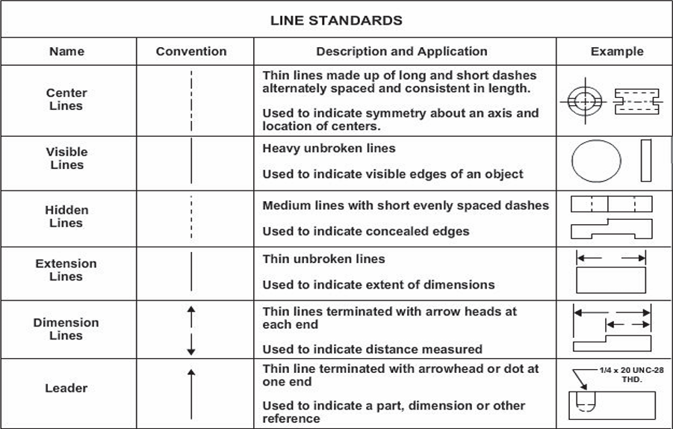
USNavy14040A - Standard Line Types (1 of 2)
(PD) U.S. Gov – NAVEDTRA14040A, 2015
Notes:
ChatGPT query identified USGovernment public domain document: https://media.defense.gov/2017/Nov/03/2002658619/-1/-1/1/171103-N-ZY182-15347.pdf Figure 2-21 on page 33

Slide 5
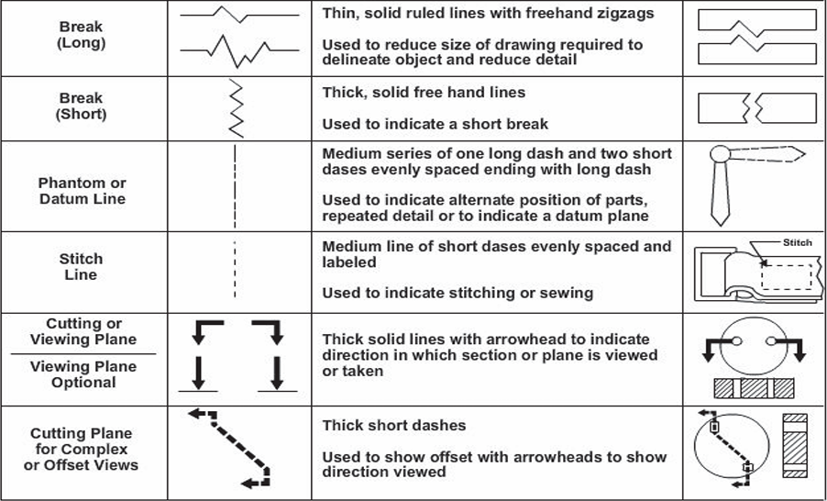
USNavy14040A - Standard Line Types (2 of 2)
(PD) U.S. Gov – NAVEDTRA14040A, 2015
Notes:
ChatGPT query identified USGovernment public domain document: https://media.defense.gov/2017/Nov/03/2002658619/-1/-1/1/171103-N-ZY182-15347.pdf Figure 2-21 on page 33

Slide 6
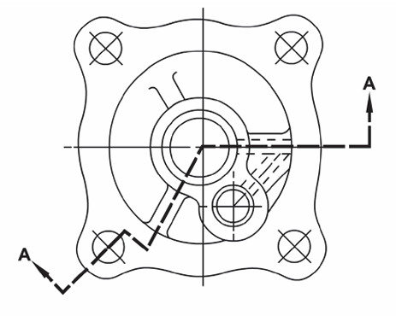
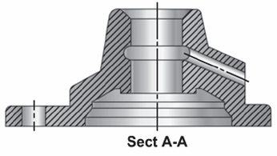
Section Lines
“In blueprints, Section Lines indicate where an imaginary cutting plane has sliced thru a solid material.” - USNavy 14040A
(PD) U.S. Gov – NAVEDTRA14040A, 2015
Aligned Section
Hashing = Cut Solid
(PD) U.S. Gov – NAVEDTRA14040A, 2015
Notes:
ChatGPT query identified USGovernment public domain document: https://media.defense.gov/2017/Nov/03/2002658619/-1/-1/1/171103-N-ZY182-15347.pdf – page 39, Figure 2-35

Slide 7
Blueprint Symbols

Slide 8
Blueprint Symbols
“Blueprint symbols are standardized universal marks
used as shorthand code
to save space, reduce errors, and
provide clear, concise, and consistent information
across technical drawings.”
- Dr. Google

Slide 9
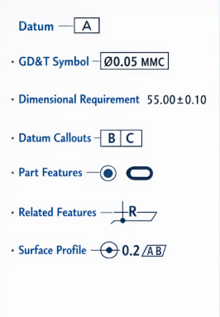
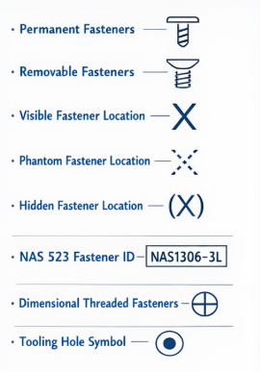
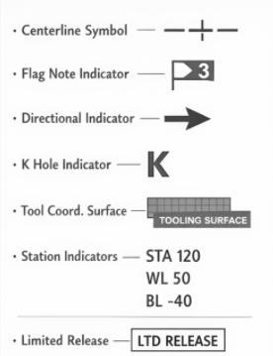
Blueprint Symbol Categories
GD&T Symbols
Fastener Symbols
Aircraft Symbols
ChatGPT / Matt Pierce, 2026
ChatGPT / Matt Pierce, 2026
ChatGPT / Matt Pierce, 2026
GD&T = Geometric Dimensioning & Tolerancing
Notes:
ChatGPT: “make a diagram comparing three different aerospace manufacturing blueprint symbol categories:
1. geometric symbols: datum, GD&T symbol, dimensional requirement, datum callouts, part features, related features, surface profile
2. fastener symbols: permanent fasteners, removable fasteners, visible fastener location, phantom fastener location, hidden fastener location, fastener identification using NAS 523 standard and four quadrants, dimensional threaded fasteners, and tooling hole symbol
3. aircraft symbols: centerline symbol, flag note indicator, directional indicator, K or coordinating hole indicator, engineered tooling coordinated surface, station indicators (STA,WL, BL) and numbers identifying distinct from 0, and limited release indicator”

Slide 10
Datum Definition
“A datum is…
a surface, line, or point
from which a geometric position
is to be determined
or from which a distance is to be measured.”
- US Navy “NAVEDTRA 1404A”
Start measuring or dimensioning from the datum.
Plane / Surface Datum
Axes / Line Datum
A
B
C
Point Datum
Matt Pierce, 2026

Slide 11
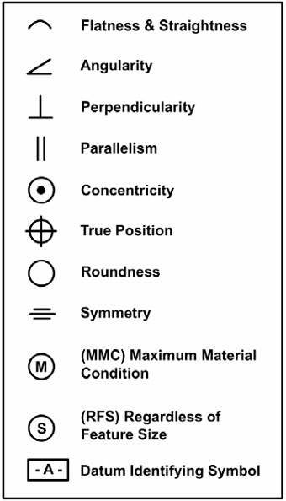
Datum Example #1 - From “USNavy14040A”
Example #1:
Geometric Characteristic Symbols
A .001
Symbol
Datum
Tolerance
Perpendicular
Ref Plane “A”
Within .001
Example #2:
A B .002 TIR
Symbol
Datum
(PD) U.S. Gov – NAVEDTRA14040A, 2015
Concentric
Two Ref Planes
Notes:
ChatGPT query identified USGovernment public domain document: https://media.defense.gov/2017/Nov/03/2002658619/-1/-1/1/171103-N-ZY182-15347.pdf (pg 75)

Slide 12
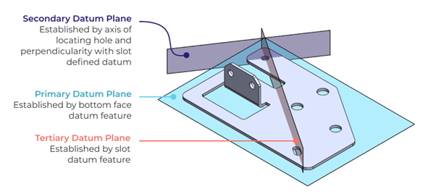
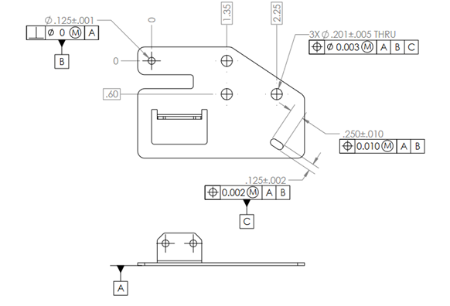
Datum Example #2 - From “ChatGPT”
ChatGPT / Matt Pierce, 2026
Generated w/ChatGPT (mpierce, 2026)
ChatGPT / Matt Pierce, 2026
Notes:
ChatGPT: make a diagram showing what a datum, datum feature, datum feature letters, and datum line are.

Slide 13
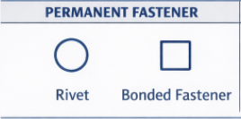
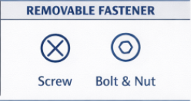
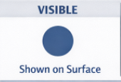
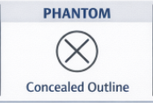
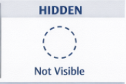




Fastener Symbols
Fastener “Type”
Fastener “Location”
Fastener “Header Style”
ChatGPT / Matt Pierce, 2026
Notes:
ChatGPT: make an infographic showing aerospace fastener symbols: permanent vs. removable fastener, visible vs. phantom vs. hidden fastener location, and anything else appropriate for the chart + make them all 2 dimensional, top-down view drawing symbols (same as how "visible", "phantom", and "hidden" fastener locations are done.)

Slide 14
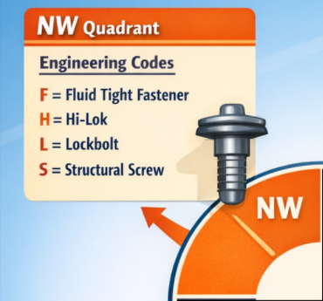
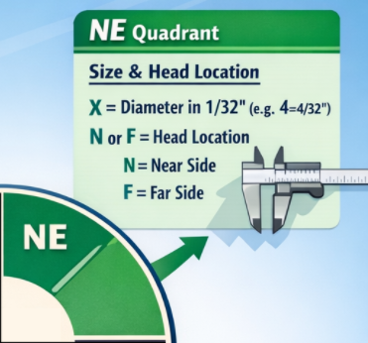

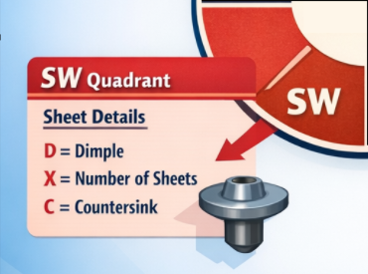
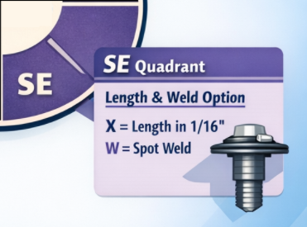
Fastener NAS 523 Identification Quadrants
ChatGPT / Matt Pierce, 2026
Notes:
ChatGPT: make an infographic about "National Aerospace Code 523", specifically it's method of symbolically identifying fasteners thru four quadrants "NW, NE, SW, and SE".
1. NW quadrant shows engineering codes for the fastener (eg: fluid tight fastener, etc.)
2. NE quadrant shows two identification codes (X = diameter of fastener in 1/32s of inch, and N or F as the location of the manufactured head)
3. SW quadrant shows three identification codes (D = Dimple, X = number of sheets to be dimpled, and C = Countersink)
4. SE quadrant shows two identification codes (X = fastener length in 1/16s of an inch, and W = spot weld option)
ChatGPT: make an infographic about NAS 523 symbolic instructions for identifying fasteners. Specifically identify the NW, NE, SW, and SE quadrants. Make it a training poster format. + remove the center circle "NAS 523 Symbol". Make the four white dividing lines intersect in the middle. + Remove the arrowheads from the horizontal gray line in middle of chart. Remove title "Symbolic Instructions for Identifying Fasteners“ + Remove label "SW QUADRANT". Remove label "SE QUADRANT. Remove label "NE QUADRANT"

Slide 15
Q&A

Slide 16
Practice Q&A’s (Q1-Q8)
Q5: Thin lines that drop away 90° from the Dimension Line arrow points to the points they are measuring?
A: Extension Lines
Q6: Cut lines showing on one view what a different view is seeing with a section removed?
A: Section Lines
Q7: Name of standardized universal marks used to save space, reduce errors, and provide consistent info on technical drawings?
A: Blueprint Symbols
Q8: Name of blueprint symbols encompassing datums, part features, surface profiles, etc.?
A: GD&T Symbols: Geometric Dimensioning & Tolerancing
Q1: Name of solid lines that depicts the shape of the part or assembly?
A: Object Lines
Q2: Name of dashed lines that depict hidden surfaces, edges, or hole walls?
A: Hidden Lines
Q3: Name of dash-dot-dash lines that indicate the middle, or symmetric on both sides?
A: Center Lines
Q4: Name of lines that have numeric lengths shown (in inches typically)?
A: Dimension Lines

Slide 17
Practice Q&A’s (Q9-Q16)
Q13: What quadrant of the NAS 523 shows the fastener diameter and location (near/far)?
A: NE
Q14: What size does the NE quadrant fastener diameter "7" represent?
A: 7/32". Number 7 is count of 1/32"s. Diameter = shorter = smaller 1/32.
Q15: What quadrant of the NAS 523 shows dimple, countersink, and # of sheets?
A: SW
Q16: What quadrant of the NAS 523 shows length and spot weld?
A: SE
Q9: Name of blueprint symbols encompassing fastener details?
A: Fastener Symbols
Q10: Name of blueprint symbols encompassing station indicators, tool surface, flag notes, etc.?
A: Aircraft Symbols
Q11: Name of a surface, a line, or a point that is a starting reference position?
A: Datum
Q12: What quadrant of the NAS 523 shows the engineering fastener code (eg: fluid tight fastener)?
A: NW

Slide 18
Practice Q&A’s (Q17)
Q17: What size does the SE quadrant fastener length "8" represent?
A: 8/16". Number 8 is count of 1/16". Length = longer = bigger 1/16.

Slide 19
Thank You
Matt Pierce - mpierce710006@gmail.com - linkedin.com/in/mpiercead576/
https://github.com/DataResearchLabs/study_guide_intro_aerospace_mfg

